Slide 1
NomNom Bot
Eduardo Herrera-Barraza, Jared Martinez Sanchez, Lily Nguyen

Slide 2
What is NomNom Bot?
GOAL: Help busy college students with making homemade meals in quick time and with ease.
Geared towards college students
AI chatbot
Provides step by step cooking directions, needed ingredients and nutrition facts
Like texting your own personal chef
Laravel framework backend, React Native frontend, PostgreSQL database

Slide 3
NomNom Bot Analysis

Slide 4
Functionality
&
Usability
Chatbot, text like interface
User types food related questions and NomNom Bot will yield immediate response as a recipe or associated information

Slide 5
System
&
Security
User accounts with specific roles and login credentials according to general user or developer/admin user
Content filter to make sure users do not submit NSFW images, text, and or other malicious code

Slide 6
Specifications

Slide 7




Specifications
Focus/Domain/Area : Target young adults in college that don’t have experience in cooking
Libraries/Frameworks/Development:
Frontend Framework:
• Expo(React Native and Typescript)
• Navigation: Expo-Router
• UI/Styling: Tailwind CSS
Backend Framework:
• Laravel(PHP)
Platform: Mobile
Genre: Mobile AI Chatbot Application
Data Source: OpenAI LLM

Slide 8
System Design

Slide 9
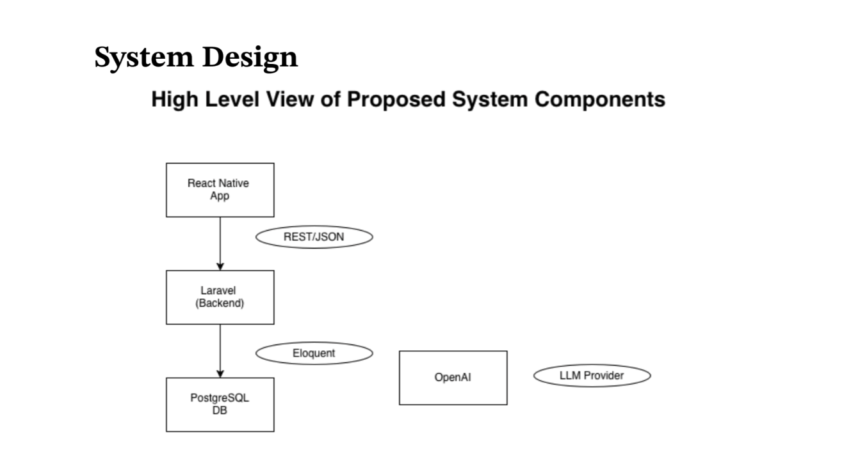

Slide 10
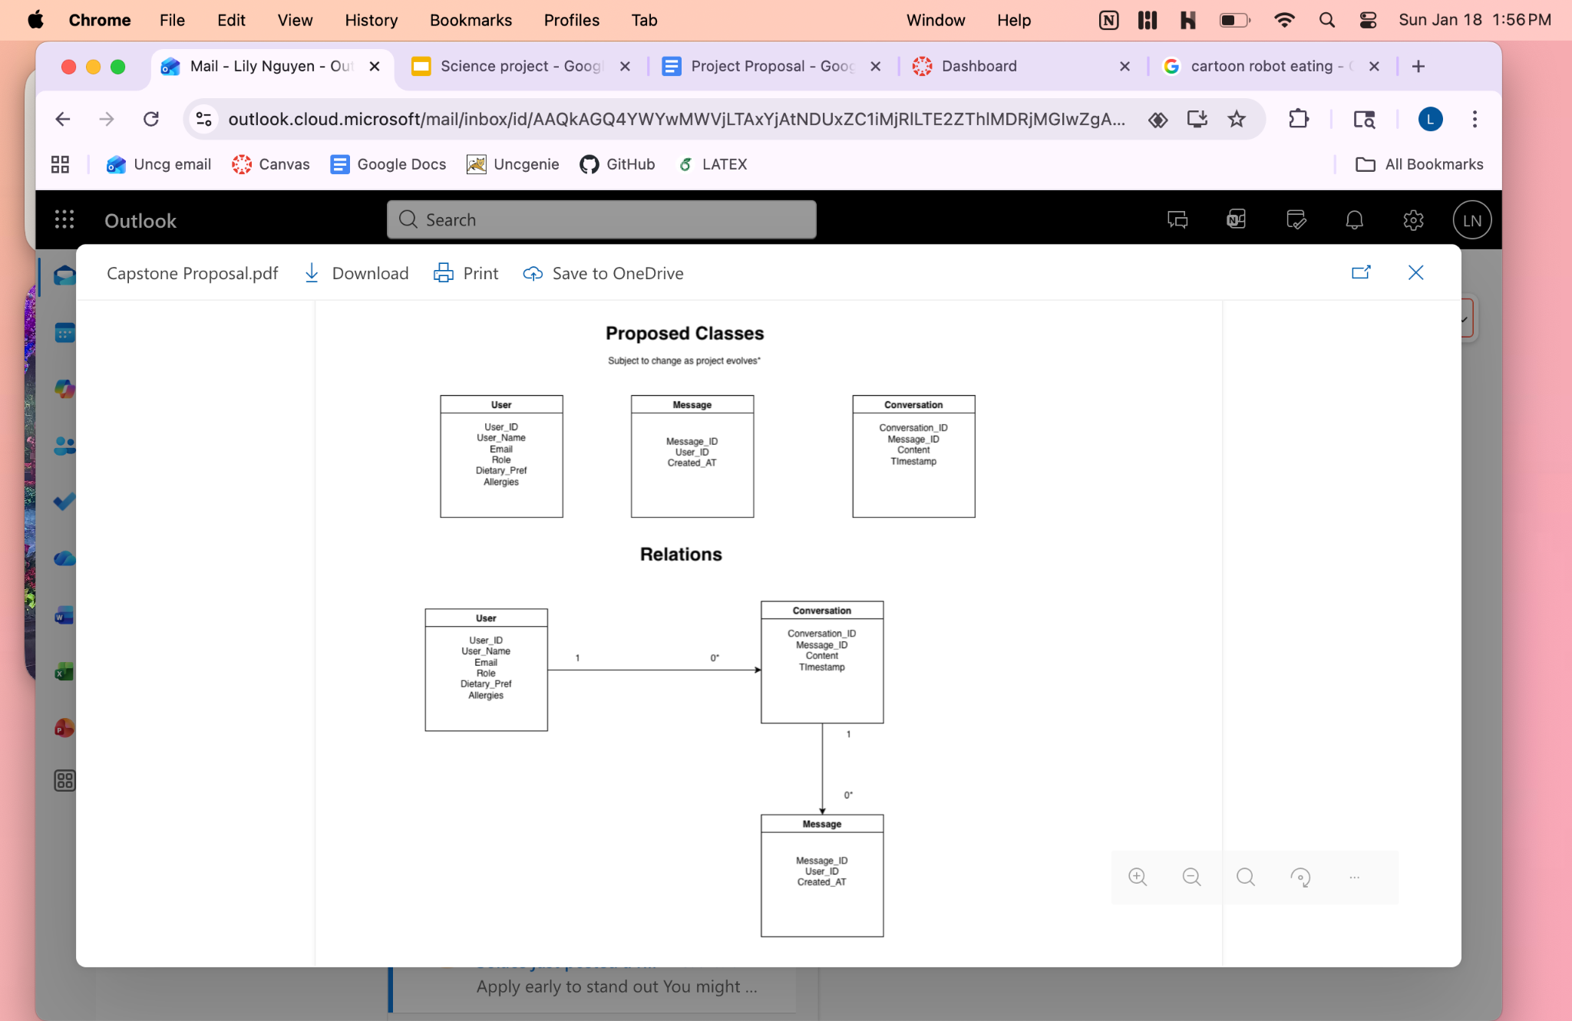

Slide 11

Bye!
Bye!

